Slide 1

Vinho Verde Wine Analysis Dashboard

Slide 2
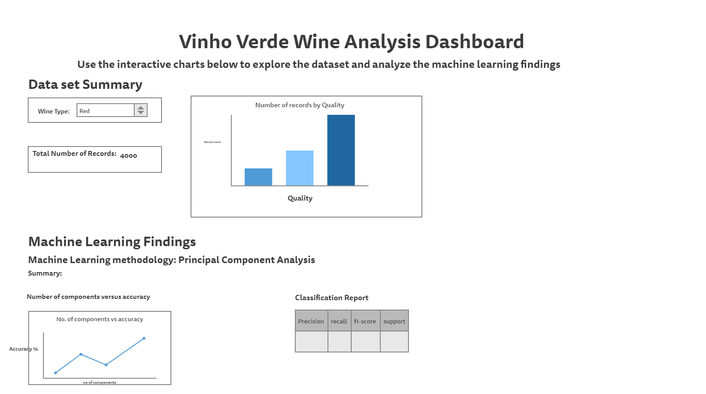

Slide 3

Tools Used to Create Dashboard
HTML
JavaScript
D3
Plotly

Slide 4
Description of Interactive Elements
Selecting Wine Type will update the following:
Total number of records analyzed
Bar chart that has record count by quality

